Slide 1
Chapter 1: Modern Network Security Threats
CCNA Security v2.0

Slide 2
Chapter Outline
1.0 Introduction
1.1 Securing Networks
1.2 Network Threats
1.3 Mitigating Threats
1.4 Summary

Slide 3
Section 1.1: Securing Networks
Upon completion of this section, you should be able to:
Describe the current network security landscape.
Explain how all types of networks need to be protected.

Slide 4
Topic 1.1.1: Current State of Affairs

Slide 5
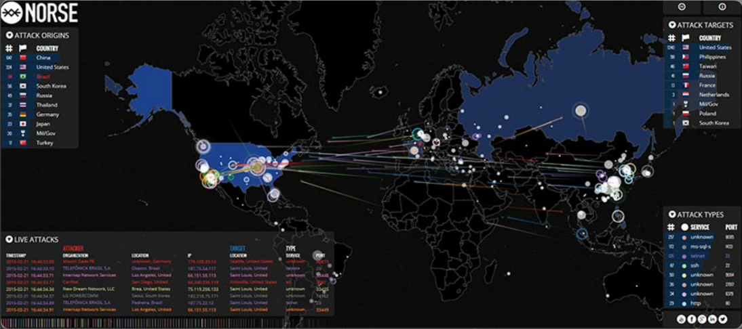
Networks Are Targets
Networks are routinely under attack. It is common to read in the news about yet another network that has been compromised.
To help comprehend the gravity of the situation, a company called Norse Dark Intelligence maintains an interactive display of current network attacks on honeypot servers.
Notes:
1.1.1.1 Networks Are Targets
http://map.ipviking.com/

Slide 6
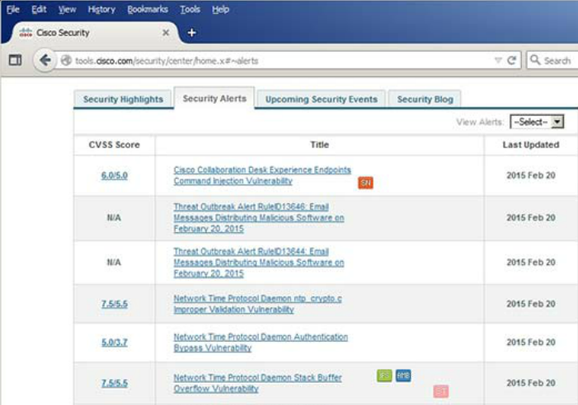
Drivers/Reasons for Network Security
Common network security terms:
Threat
Vulnerability
Mitigation
Risk
Cisco Security Intelligence Operations
Network security relates directly to an organization's business continuity. Network security breaches can disrupt e-commerce, cause the loss of business data, threaten people’s privacy, and compromise the integrity of information.
One tool available to help network administrators adapt, develop, and implement mitigation techniques is provided by Cisco. The Cisco Security Intelligence Operations (SIO) provides alerts to network professionals regarding current network attacks.
Notes:
1.1.1.2 Drivers for Network Security

Slide 7
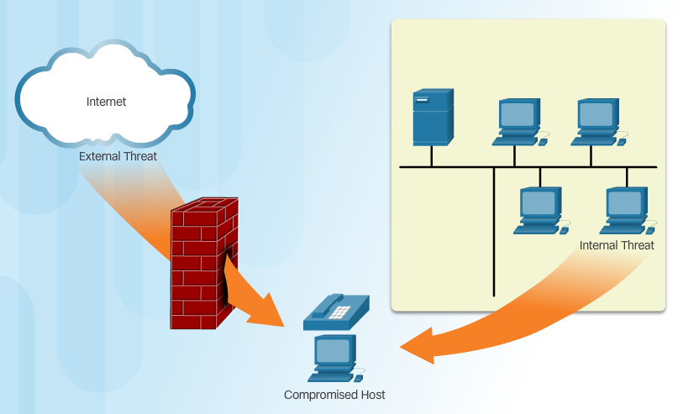
Vectors of Network Attacks
An attack vector is a path or other means by which an attacker can gain access to a server, host, or network.
Notes:
1.1.1.3 Vectors of Network Attacks

Slide 8
Data Loss
Data is likely to be an organization’s most valuable asset. Organizational data can include research and development data, sales data, financial data, human resource and legal data, employee data, contractor data, and customer data.
Data loss or data exfiltration is when data is intentionally or unintentionally lost, stolen, or leaked to the outside world.
Vectors of data loss:
Email/Webmail
Unencrypted Devices
Cloud Storage Devices
Removable Media
Hard Copy
Improper Access Control
Notes:
1.1.1.4 Data Loss

Slide 9
Topic 1.1.2: Network Topology Overview

Slide 10
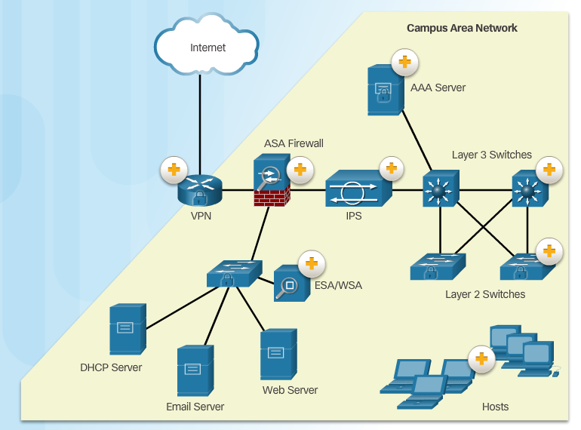
Campus Area Networks
All networks are targets. However, the main focus of this course is on securing Campus Area Networks (CANs). Campus Area Networks consists of interconnected LANs within a limited geographic area.
Notes:
1.1.2.1 Campus Area Networks

Slide 11
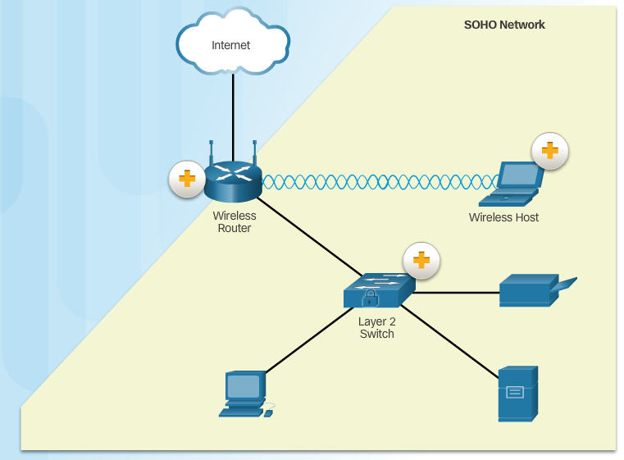
Small Office and Home Office Networks
It is important that all types of networks, regardless of size, are protected. Attackers are also interested in home networks and small office and home office (SOHO) networks. They may want to use someone's Internet connection for free, use the Internet connection for illegal activity, or view financial transactions, such as online purchases.
Notes:
1.1.2.2 Small Office and Home Office Networks

Slide 12
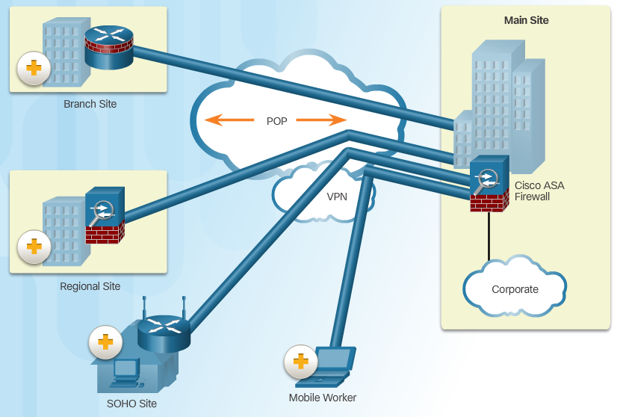
Wide Area Networks
Wide Area Networks (WANs) span a wide geographical area, often over the public Internet. Organizations must ensure secure transport for the data in motion as it travels between sites.
Notes:
1.1.2.3 Wide Area Networks

Slide 13
Data Center Networks
Outside perimeter security:
On-premise security officers
Fences and gates
Continuous video surveillance
Security breach alarms
Inside perimeter security:
Electronic motion detectors
Security traps
Continuous video surveillance
Biometric access and exit sensors
Data center networks are typically housed in an off-site facility to store sensitive or proprietary data. These sites are interconnected to corporate sites using VPN technology with ASA devices and integrated data center switches, such as a high-speed Nexus switches.
Notes:
1.1.2.4 Data Center Networks

Slide 14
Cloud and Virtual Networks
VM-specific threats:
Hyperjacking
Instant On activation
Antivirus storm
Components of a secure data center:
Secure segmentation
Threat defense
Visibility
Hyperjacking - An attacker could hijack a VM hypervisor (VM controlling software) and then use it as a launch point to attack other devices on the data center network.
Instant On Activation - When a VM that has not been used for a period of time is brought online, it may have outdated security policies that deviate from the baseline security and can introduce security vulnerabilities.
Antivirus Storms - This happens when all VMs attempt to download antivirus data files at the same time.
The Evolving Network Border
Mobile Device Management
Critical MDM functions for BYOD network:
Data encryption
PIN enforcement
Data wipe
Data loss prevention
Jailbreak/root detection
Secure segmentation - ASA devices and a Virtual Security Gateway integrated into the Cisco Nexus Series switches are deployed in a data center network to provide secure segmentation. This provides granular inter-virtual-machine security.
Visibility - Visibility solutions are provided using software such as the Cisco Security Manager which help simplify operations and compliance reporting.
Notes:
1.1.2.5 Cloud and Virtual Networks
1.1.2.6 The Evolving Network Border
1.1.2.7 Activity - Network Topology Protection Overview

Slide 15
Section 1.2: Network Threats
Upon completion of the section, you should be able to:
Describe the evolution of network security.
Describe the various types of attack tools used by hackers.
Describe malware.
Explain common network attacks.

Slide 16
Topic 1.2.1: Who is Hacking Our Networks?

Slide 17

The Hacker & The Evolution of Hackers
Vulnerability Brokers - These are usually grey hat hackers who attempt to discover exploits and report them to vendors, sometimes for prizes or rewards.
Hacktivist - These are grey hat hackers who rally and protest against different political and social ideas. Hacktivists publicly protest against organizations or governments by posting articles, videos, leaking sensitive information, and performing distributed denial of service (DDoS) attacks.
Modern hacking titles:
Script Kiddies
Vulnerability Brokers
Hacktivists
Cyber Criminals
State-Sponsored Hackers
Hacker is a common term used to describe a network attacker. In this course, the terms attacker and hacker are often used interchangeably. However, the term “hacker” has a variety of meanings:
Notes:
1.2.1.1 The Hacker
1.2.1.2 The Evolution of Hackers
1.2.1.3 Cyber Criminals
1.2.1.4 Hacktivists
1.2.1.5 State-Sponsored Hackers

Slide 18
Topic 1.2.2: Hacker Tools

Slide 19
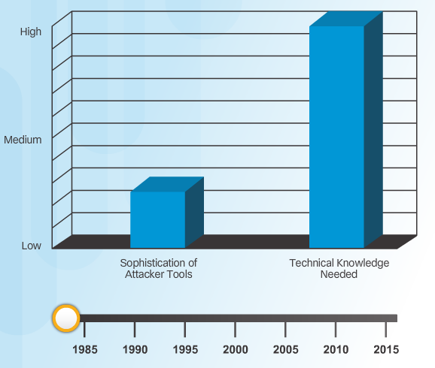
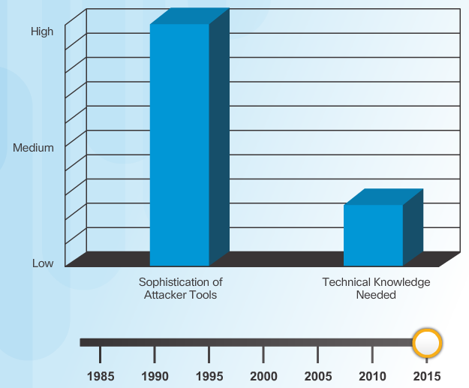
Introduction of Attack Tools
To exploit vulnerability, an attacker must have a technique or tool that can be used. Over the years, attack tools have become more sophisticated, and highly automated, requiring less technical knowledge to use them than in the past.
Notes:
1.2.2.1 Introduction of Attack Tools

Slide 20
Evolution of Security Tools
Penetration testing tools:
Password crackers
Wireless hacking
Network scanning and hacking
Packet crafting
Packet sniffers
Rootkit detectors
Fuzzers to search vulnerabilities
Forensic
Debuggers
Hacking operating systems
Encryption
Vulnerability exploitation
Vulnerability Scanners
Notes:
1.2.2.2 Evolution of Security Tools

Slide 21
Categories of Attack Tools
Network hacking attacks:
Eavesdropping
Data modification
IP address spoofing
Password-based
Denial-of-service
Man-in-the-middle
Compromised-key
Sniffer
Notes:
1.2.2.3 Categories of Attack Tools

Slide 22
Topic 1.2.3: Malware
The focus of this topic is on threats for end devices. Specifically, end devices are prone to malware attacks. It is important to know about malware because hackers and online criminals rely on users to install malware or help exploit the security gaps.

Slide 23
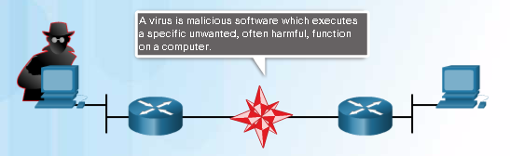
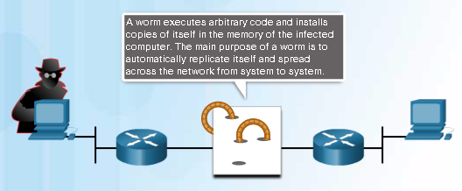
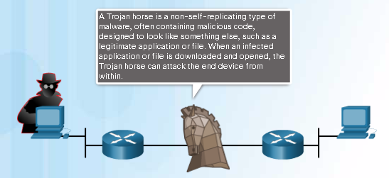
Various Types of Malware
Notes:
1.2.3.1 Various Types of Malware

Slide 24

Viruses
Notes:
1.2.3.2 Viruses

Slide 25
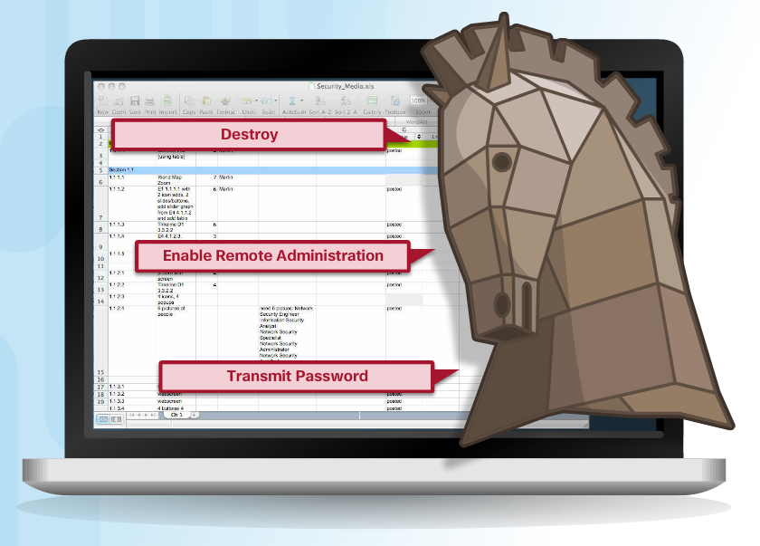
Trojan Horse Classification
The term Trojan horse originated from Greek mythology. Greek warriors offered the people of Troy (Trojans) a giant hollow horse as a gift, as shown in the figure. The Trojans brought the giant horse into their walled city, unaware that it contained many Greek warriors. At night, after most Trojans were asleep, the warriors burst out of the horse and overtook the city
Classifications:
Security software disabler
Remote-access
Data-sending
Destructive
Proxy
FTP
DoS
Notes:
1.2.3.3 Trojan Horses
1.2.3.4 Trojan Horse Classification

Slide 26
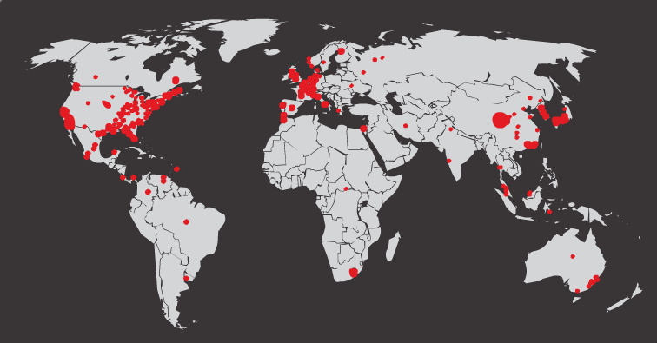
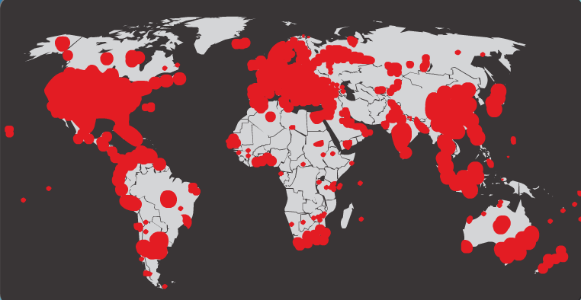
Worms
Worms replicate themselves by independently exploiting vulnerabilities in networks. Worms usually slow down networks.
Whereas a virus requires a host program to run, worms can run by themselves. Other than the initial infection, they no longer require user participation. After a host is infected, the worm is able to spread very quickly over the network.
Initial Code Red Worm Infection
In 2001 the Code Red worm had infected 658 servers. Within 19 hours, the worm had infected over 300,000 servers
Code Red Worm Infection 19 Hours Later
Notes:
1.2.3.5 Worms

Slide 27
Worm Components
Enabling vulnerability - A worm installs itself using an exploit mechanism, such as an email attachment, an executable file, or a Trojan horse, on a vulnerable system.
Propagation mechanism - After gaining access to a device, the worm replicates itself and locates new targets.
Payload - Any malicious code that results in some action is a payload. Most often this is used to create a backdoor to the infected host or create a DoS attack.
Code Red Worm Propagation
1. Propagate for 19 days
2. Launch DoS attack for next 7 days
3. Stop and go dormant for a few days
4. Repeat the cycle
Components:
Enabling vulnerability
Propagation mechanism
Payload
Despite the mitigation techniques that have emerged over the years, worms have continued to evolve with the Internet and still pose a threat. While worms have become more sophisticated over time, they still tend to be based on exploiting weaknesses in software applications.
Most worm attacks consist of three components, as shown above.
Notes:
1.2.3.6 Worm Components

Slide 28

Other Malware
Hackers have used viruses, worms, and Trojan horses to carry their payloads and for other malicious reasons. Malware continues to evolve.
These are some examples of the variety of modern malware
Ransomware
Spyware
Adware
Scareware
Phishing
Rootkits
Notes:
1.2.3.7 Other Malware
1.2.3.8 Activity - Identify the Malware Type

Slide 29
Topic 1.2.4: Common Network Attacks

Slide 30
Types of Network Attacks
Many types of attacks
Data Modification
Syn Flood
Smurf Attack
Reconnaissance Access DoS
To mitigate attacks, it is useful to first categorize the various types of attacks. By categorizing network attacks, it is possible to address types of attacks rather than individual attacks. There is no standardized way of categorizing network attacks.
The method used in this course classifies attacks in three major categories
Notes:
1.1.1.1 Networks Are Targets

Slide 31

Reconnaissance Attacks
Reconnaissance is known as information gathering. It is analogous to a thief surveying a neighborhood by going door-to-door pretending to sell something. What the thief is actually doing is looking for vulnerable homes to break into such as unoccupied residences, residences with easy-to-open doors or windows, and those residences without security systems or security cameras.
Initial query of a target
Ping sweep of the target network
Port scan of active IP addresses
Vulnerability scanners
Exploitation tools
Notes:
1.2.4.2 Reconnaissance Attacks
1.2.4.3 Sample Reconnaissance Attacks

Slide 32
Access Attacks
A few reasons why hackers use access attacks:
To retrieve data
To gain access
To escalate access privileges
A few types of access attacks include (common types of access attacks):
Password
Trust exploitation
Port redirection
Man-in-the-middle
Buffer overflow
IP, MAC, DHCP spoofing
Access attacks exploit known vulnerabilities in authentication services, FTP services, and web services to gain entry to web accounts, confidential databases, and other sensitive information.
There are at least three reasons that hackers would use access attacks on networks or systems:
Notes:
1.2.4.5 Access Attacks
1.2.4.6 Types of Access Attacks

Slide 33
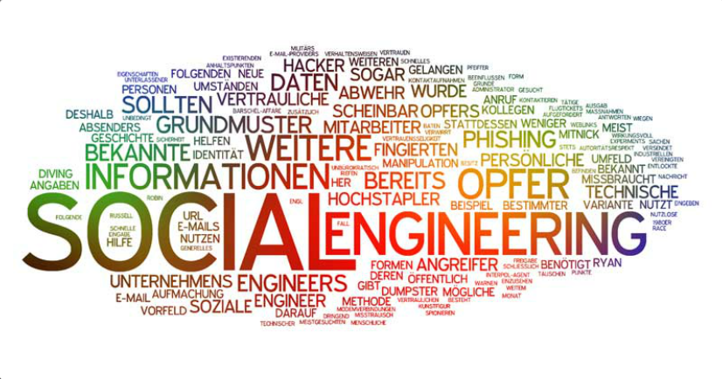
Social Engineering Attacks
Pretexting
Phishing
Spearphishing
Spam
Tailgating
Something for Something
Baiting
Pretexting - This is when a hacker calls an individual and lies to them in an attempt to gain access to privileged data. An example involves an attacker who pretends to need personal or financial data in order to confirm the identity of the recipient.
Spear phishing - This is a targeted phishing attack tailored for a specific individual or organization.
Tailgating - This is when a hacker quickly follows an authorized person into a secure location. The hacker then has access to a secure area.
Something for Something (Quid pro quo) - This is when a hacker requests personal information from a party in exchange for something like a free gift.
Notes:
1.2.4.6 Social Engineering

Slide 34
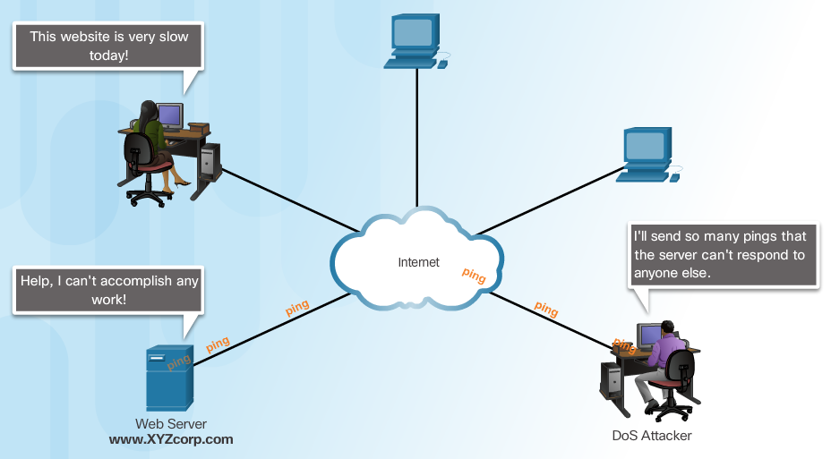
Denial of Service Attacks
Denial-of-Service (DoS) attacks are highly publicized network attacks. A DoS attack results in some sort of interruption of service to users, devices, or applications.
There are two major sources of DoS attacks:
Maliciously Formatted Packets
Overwhelming Quantity of Traffic
Notes:
1.2.4.7 Denial of Service Attacks
1.2.4.8 Types of DoS Attacks

Slide 35
DDoS Attacks As an example, a DDoS attack could proceed as follows:
Hacker builds a network of infected machines
A network of infected hosts is called a botnet.
The compromised computers are called zombies.
Zombies are controlled by handler systems.
Zombie computers continue to scan and infect more targets
Hacker instructs handler system to make the botnet of zombies carry out the DDoS attack
A Distributed DoS Attack (DDoS) is similar in intent to a DoS attack, except that a DDoS attack increases in magnitude because it originates from multiple, coordinated sources. DDoS attacks also introduce new terms such as botnet, handler systems, and zombie computers.
Notes:
1.2.4.9 DDoS Attacks
1.2.4.10 DDoS Attacks (cont.) - Video https://www.youtube.com/watch?v=NogCN78XN2w
1.2.4.11 Activity - Identify the Types of Attack
1.2.4.12 Lab - Social Engineering

Slide 36
1.3 Mitigating Threats
Upon completion of this section, you should be able to::
Describe methods and resources to protect the networks.
Describe a collection of domains for network security.
Explain the purpose of the Cisco SecureX Architecture.
Describe the techniques used to mitigate common network attacks.
Explain how to secure the three functional areas of Cisco routers and switches.

Slide 37
Topic 1.3.1: Defending the Network

Slide 38

Network Security Professionals
Notes:
1.3.1.1 Network Security Professionals

Slide 39
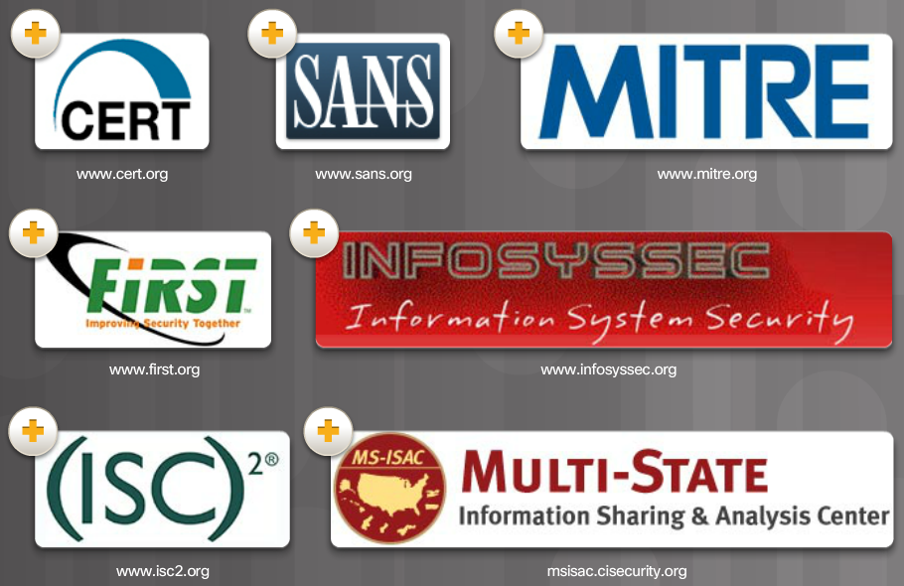
Network Security Organizations
Notes:
1.3.1.2 Network Security Organizations

Slide 40
Confidentiality, Integrity, Availability
Components of Cryptography
Confidentiality: Uses encryption to encrypt and hide data.
Integrity: Uses hashing algorithms to ensure data is unaltered during operation.
Availability: Assures data is accessible. Guaranteed by network hardening mechanisms and backup systems.
In addition to preventing and denying malicious traffic, network security professionals must also ensure that data is protected.
Cryptography, the study and practice of hiding information, is used extensively in modern network security. Today, each type of network communication has a corresponding protocol or technology designed to hide that communication from anyone other than the intended user.
Notes:
1.3.1.3 Confidentiality, Integrity, Availability

Slide 41
Topic 1.3.2: Domains of Network Security

Slide 42
Network Security Domains
Risk assessment
Security policy
Organization of information security
Asset management
Human resources security
Physical and environmental security
Communications and operations management
Information systems acquisition, development, and maintenance
Access control
Information security incident management
Business continuity management
Compliance
It is vital for network security professionals to understand the reasons for network security. They must also be familiar with the organizations dedicated to network security, as well as the 12 network security domains.
Notes:
1.3.2.1 Network Security Domains

Slide 43

Network Security Policy
One of the most important domains is the security policy domain. A security policy is a formal statement of the rules by which people that are given access to the technology and information assets of an organization, must abide
Notes:
1.3.2.2 Security Policy
1.3.2.3 Network Security Policy

Slide 44

Network Security Policy Objectives
Notes:
1.3.2.4 Network Security Policy Objectives

Slide 45
Topic 1.3.3: Introducing the Cisco SecureX Architecture

Slide 46
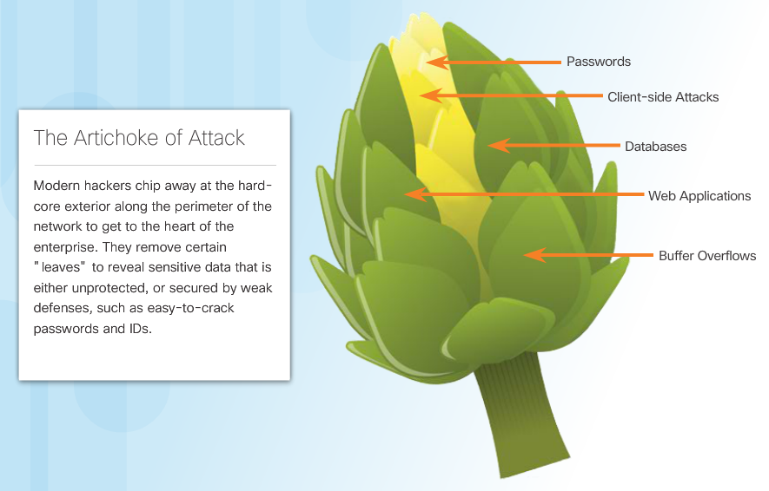
The Security Artichoke
A common analogy used to describe what a hacker must do to launch an attack was called the “Security Onion.” In the analogy, a hacker would have to peel away at a network’s defense mechanisms in a similar manner to peeling an onion.
Notes:
1.3.3.1 The Security Artichoke

Slide 47
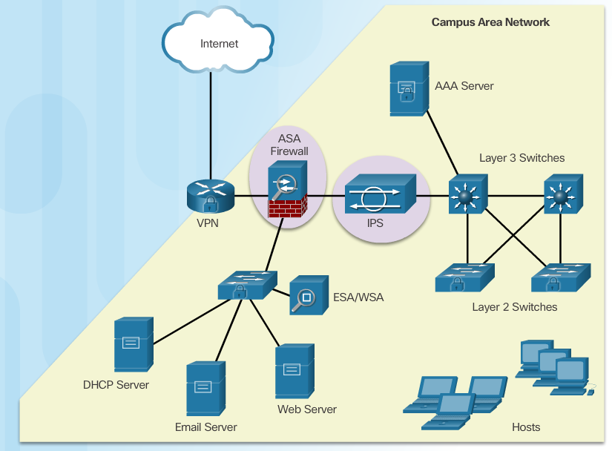
Evolution of Network Security Tools
In the 1990s, network security became an integral part of everyday operations. Tools and devices emerged that were dedicated to a particular network security function.
One of the first network security tools was the intrusion detection system (IDS). IDS and now the newer intrusion prevention system (IPS), provide real-time detection of certain types of attacks. Unlike an IDS, an IPS can also automatically block the attack in real-time.
Notes:
1.3.3.2 Evolution of Network Security Tools

Slide 48
SecureX Product Families
Increased user mobility, the influx of consumer devices, and movement of information to non-traditional locations has created complexities for securing the IT infrastructure. Deploying piecemeal security solutions can lead to duplicated efforts and inconsistent access policies, and requires increased integration and staffing to support.
Cisco SecureX products work together to provide effective security for any user, using any device, from any location, at any time. This is one of the primary reasons for relying on the Cisco SecureX architecture to help shape the security policy.
In the figure, click each of the five major product categories of the SecureX architecture for a brief description
SecureX
Server Edge and Branch
Secure Email and Web
Secure Mobility
Secure Access
Secure Data Center and Virtualization
Notes:
1.3.3.3 SecureX Products

Slide 49
SecureX Security Technology
The Cisco SecureX architecture is designed to provide effective security for any user, using any device, from any location, and at any time. This new security architecture uses a higher-level policy language that takes into account the full context of a situation - who, what, where, when and how. With highly distributed security policy enforcement, security is pushed closer to where the end user is working.
This architecture includes the following five major components :
Scanning engines
Delivery mechanisms
Security intelligence operations (SIO)
Policy management consoles
Next-generation endpoint
Notes:
1.3.3.4 SecureX Security Technology

Slide 50

Centralized Context-Aware Network Scanning Element
A context-aware policy uses a simplified descriptive business language to define security policies based on five parameters:
Type of device being used for access
Person’s identity
Application in use
Location
Time of access
The SecureX architecture can significantly improve business efficiency and flexibility. However, that flexibility creates complexities for the IT infrastructure and any efforts to keep the infrastructure secure.
To scale this new computing model, a context-aware network scanning element that uses policies to enforce security can be deployed. A context-aware scanning element is a network security device that examines packets on the wire, but also looks at external information to understand the full context of the situation. To be context aware, the scanner must consider the ‘who, what, where, when, and how’ of a packet as it relates to security.
Notes:
1.3.3.5 Centralized Context-Aware Network Scanning Element

Slide 51
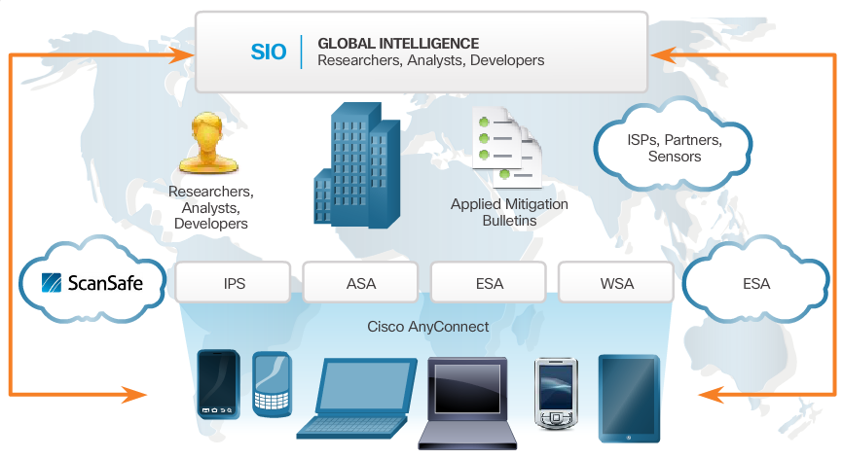
Cisco Security Intelligence Operations
Notes:
1.3.3.6 Cisco Security Intelligence Operations
To help keep the Cisco Intrusion Prevention Systems (IPS), Adaptive Security Appliance (ASA), Email Security Appliance (ESA), and Web Security Appliance (WSA) devices secure, Cisco designed the Security Intelligence Operations (SIO). The SIO is a Cloud-based service that connects global threat information, reputation-based services, and sophisticated analysis, to Cisco network security devices.
As illustrated in Figure 1, Cisco SIO is the world’s largest Cloud-based security ecosystem, using almost a million live data feeds from deployed Cisco ESA, WSA, ASA, and IPS solutions. The researchers, analysts, and developers at SIO then weigh and process the data, automatically categorizing threats and creating rules using more than 200 parameters. Rules are dynamically delivered to deployed Cisco SecureX IPS, ESA, WSA, and ASA security devices every three to five minutes.

Slide 52
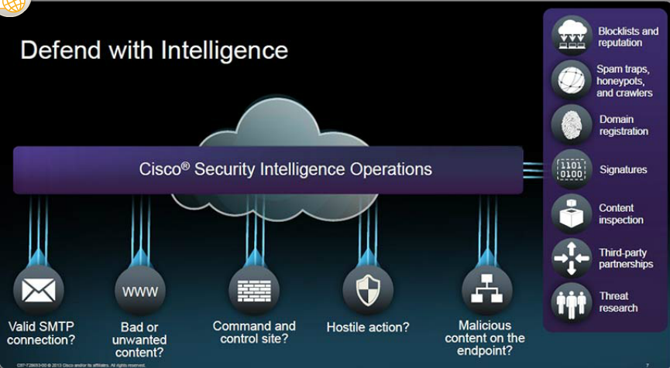
Cisco Security Intelligence Operations (cont.)
Notes:
1.3.3.6 Cisco Security Intelligence Operations
As shown in Figure 2, the SIO can authenticate valid email traffic, filter nefarious websites, and identify hostile actions and malicious content on endpoints. The SIO uses a variety of sources when identifying and categorizing threats:
Blacklist and reputation filters
Information gathered by spam traps, honeypots, and crawlers
Identifying and registering valid website domains
Known database of attack signatures
Performing content inspection
Using third party partnerships
A full-time threat research team consisting of dedicated white hat network specialists

Slide 53
Topic 1.3.4: Mitigating Common Network Threats

Slide 54
Defending the Network
Best practices:
Develop a written security policy.
Educate employees about the risks of social engineering, and develop strategies to validate identities over the phone, via email, or in person.
Control physical access to systems.
Use strong passwords and change them often.
Encrypt and password-protect sensitive data.
Implement security hardware and software.
Perform backups and test the backed up files on a regular basis.
Shut down unnecessary services and ports.
Keep patches up-to-date by installing them weekly or daily to prevent buffer overflow and privilege escalation attacks.
Perform security audits to test the network.
Notes:
1.3.4.1 Defending the Network

Slide 55
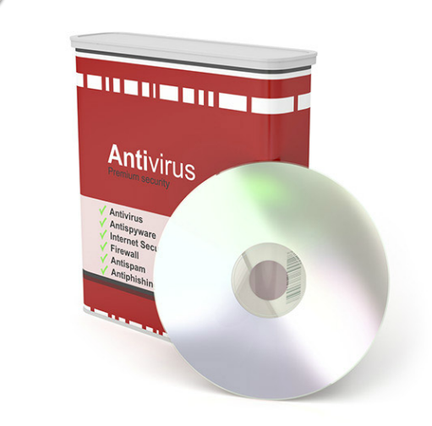
Mitigating Malware
Malware including viruses, worms, and Trojan horses, can cause serious problems on networks and end devices. Network administrators have several means of mitigating these attacks.
The primary means of mitigating virus and Trojan horse attacks is antivirus software. Antivirus software helps prevent hosts from getting infected and spreading malicious code. It requires much more time to clean up infected computers than it does to maintain up-to-date antivirus software and antivirus definitions on the same machines.
Notes:
1.3.4.2 Mitigating Malware

Slide 56
Mitigating Worms
Worms are more network-based than viruses. Worm mitigation requires diligence and coordination on the part of network security professionals.
As shown in the figure, the response to a worm attack can be broken down into four phases:
Containment
Inoculation
Quarantine
Treatment
Containment
Inoculation
Quarantine
Treatment
Notes:
1.3.4.3 Mitigating Worms

Slide 57
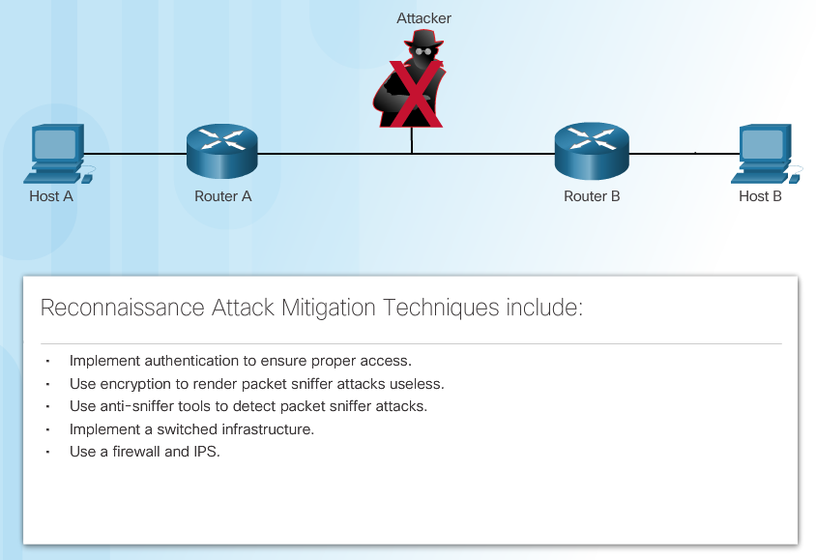
Mitigating Reconnaissance Attacks
Reconnaissance attacks are typically the precursor to additional attacks, with the intent of gaining unauthorized access to a network or disrupting network functionality. A network security professional can detect when a reconnaissance attack is underway by receiving notifications from preconfigured alarms. These alarms are triggered when certain parameters are exceeded, such as the number of ICMP requests per second. A variety of technologies and devices can be used to monitor this type of activity and generate an alarm. Cisco’s Adaptive Security Appliance (ASA) provides intrusion prevention in a standalone device. Additionally, the Cisco ISR supports network-based intrusion prevention through the Cisco IOS security image.
Notes:
1.3.4.4 Mitigating Reconnaissance Attacks

Slide 58
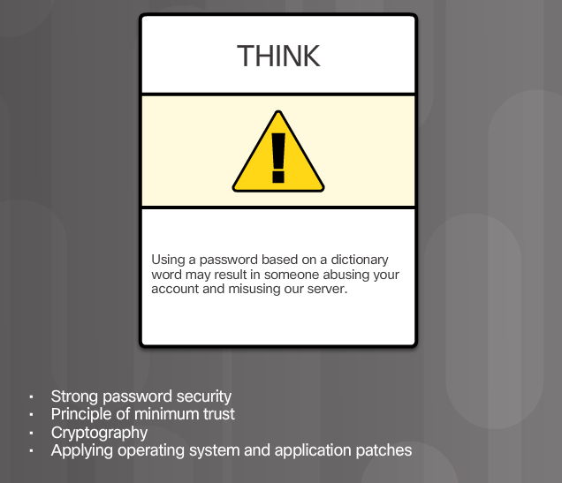
Mitigating Access Attacks
Several techniques are available for mitigating access attacks, as shown in the figure.
A surprising number of access attacks are carried out through simple password guessing or brute-force dictionary attacks against passwords. To defend against this, create and enforce a strong authentication policy which includes:
Use strong password
Disable accounts after a specified number of unsuccessful logins has occurred
Notes:
1.3.4.5 Mitigating Access Attacks

Slide 59
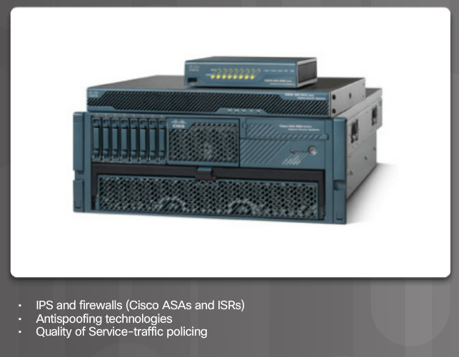
Mitigating DoS Attacks
One of the first signs of a DoS attack is a large number of user complaints about unavailable resources. To minimize the number of attacks, a network utilization software package should be running at all times. This should also be required by the network security policy. A network utilization graph showing unusual activity could also indicate a DoS attack.
Notes:
1.3.4.6 Mitigating DoS Attacks

Slide 60
Topic 1.3.5: Cisco Network Foundation Protection Framework

Slide 61
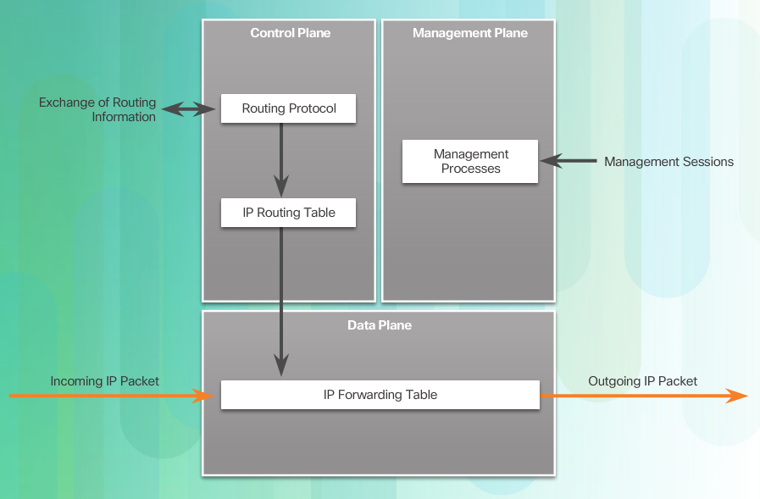
NFP Framework
The Cisco Network Foundation Protection (NFP) framework provides comprehensive guidelines for protecting the network infrastructure. These guidelines form the foundation for continuous delivery of service.
NFP logically divides routers and switches into three functional areas, as shown in the figure:
Notes:
1.3.5.1 NFP Framework

Slide 62
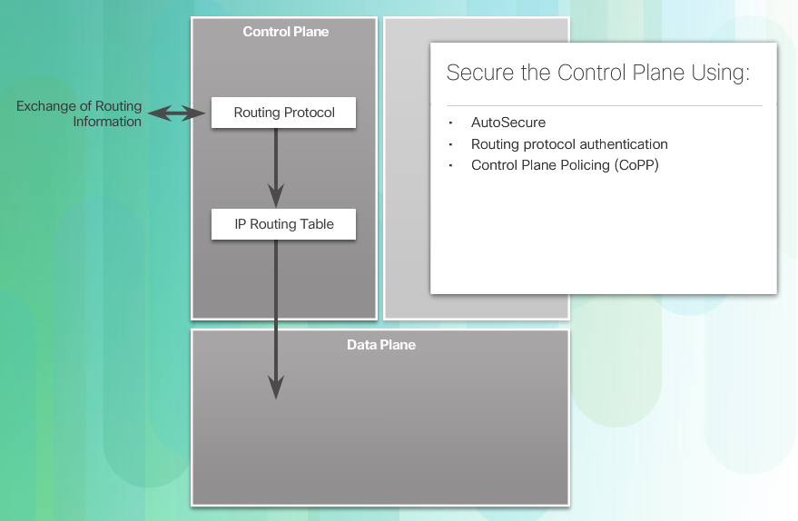
Securing the Control Plane
Control Plane Policing (CoPP) - CoPP is a Cisco IOS feature designed to allow users to control the flow of traffic that is handled by the route processor of a network device.
Notes:
1.3.5.2 Securing the Control Plane

Slide 63
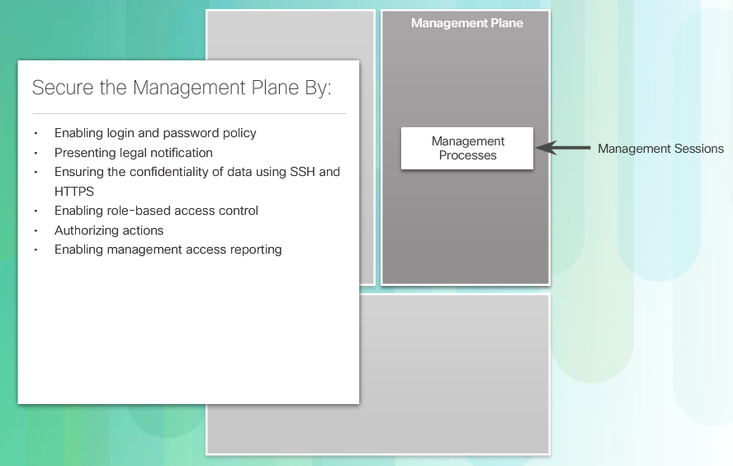
Securing the Management Plane
Management plane traffic is generated either by network devices or network management stations using processes and protocols such as Telnet, SSH, and TFTP, etc. The management plane is a very attractive target to hackers. For this reason, the management module was built with several technologies designed to mitigate such risks.
Notes:
1.3.5.3 Securing the Management Plane

Slide 64
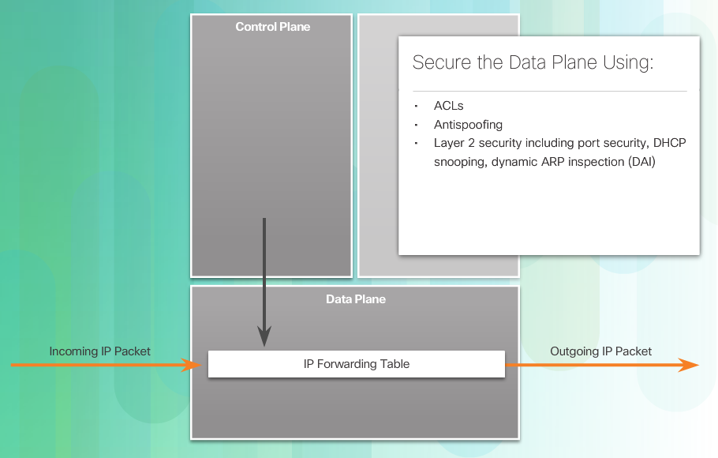
Securing the Data Plane
Data plane traffic consists mostly of user-generated packets being forwarded through the router via the data plane. Data plane security can be implemented using ACLs, antispoofing mechanisms, and Layer 2 security features, as shown in the figure.
Notes:
1.3.5.4 Securing the Data Plane
1.3.5.5 Activity - Identify Characteristics of the NFP Framework

Slide 65
Section 1.4: Summary
Chapter Objectives:
Explain network security.
Describe various types of threats and attacks.
Explain tools and procedures to mitigate the effects of malware and common network attacks.
Notes:
1.4.1.1 Lab - Researching Network Attacks and Security Audit Tools
1.4.1.2 Summary

Slide 67
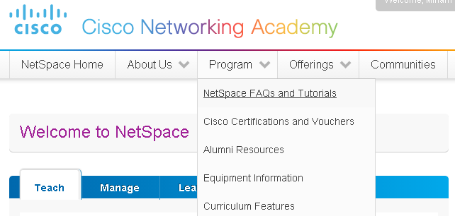
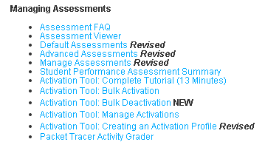
Instructor Resources
Remember, there are helpful tutorials and user guides available via your NetSpace home page. (https://www.netacad.com)
These resources cover a variety of topics including navigation, assessments, and assignments.
A screenshot has been provided here highlighting the tutorials related to activating exams, managing assessments, and creating quizzes.
1
2
Notes:
https://www.netacad.com

